Slide 1

National Center for Spectator Sports Safety and Security Advisory Board Meeting
9 July 2018
Louisville, KY

Slide 2
Overview
Introductions
The National Center Since 2017
2018-2020 Strategic Plan
The Way Ahead

Slide 3
Introductions
Dr. Lou Marciani
Kurt…
Etc.

Slide 4
The National Center Since 2017
New Advisory Board and Technology Alliance
New Personnel
Three PhDs
Instructional Design Specialist
Finance Officer
Two Training Officers
Special Projects Officer
NSSL Manager
Financials
52% Enterprise Funding
48% Grant Funding
New FEMA Grant
New Mississippi Office of Homeland Security Grant
New Grant from Honeywell Corporation
Accomplishments
Inaugurated Research Fellows Program
Launched National Sport Security Laboratory
Doubled FEMA Course Offerings
Completed Mississippi Office of Homeland Security Work on CSVS
Two New Courses Accredited by INTERPOL
New Hotel Security Course

Slide 5
The National Center Since 2017
In-Process
New Courses
High School Risk Management Course
Venue Staff Supervisors Course
Manager-Level Sports Security Professional Course
Two New INTERPOL Courses
Crisis Communications Course
Best Practices
Meeting Planners International
International Sports Safety and Security
International
Offer INTERPOL Training in 192 Nations
Announce International Sports Security Professional Program
Counterterrorism Course
New Knowledge Portal
New Risk Assessment Tool
Double FEMA Course Offerings
Develop Training Academy

Slide 6

2018-2020 Strategic Plan
Our Vision
Be the world’s leading academic research institution in addressing sport safety and security risks and threats.
Our Mission
Conduct innovative research, deliver quality training, enhance professional development, and assess security solutions thus, contributing to the standards and core competencies of the profession.
Accomplishing the Mission
Four pillars – Applied Research, Professional Development, Training, and New Knowledge
Collaborative efforts of scholars and practitioners in academia, industry and government

Slide 7
2018 – 2020 Strategic Plan
Prioritizes Applied Research
Research Fellows Program
NSSL Activities
New Industry Peer-Reviewed Journal
Increases Professional Development Programs
Venue Staff Supervisor Course
Manager-Level Sport Security Certificate Program
International Sport Security Professional Certificate Program
Continuing Education Units
Increases Training Offerings
Double the FEMA Offerings
INTERPOL Courses for 192 Nations
Three New FEMA Courses
Four New INTERPOL Courses
Creates New Knowledge
Sports Security Risk Model
Venue Model
Validated Sports Security Competencies
Baseline International Sport Security Competencies
International Sports Safety and Security Best Practices

Slide 8
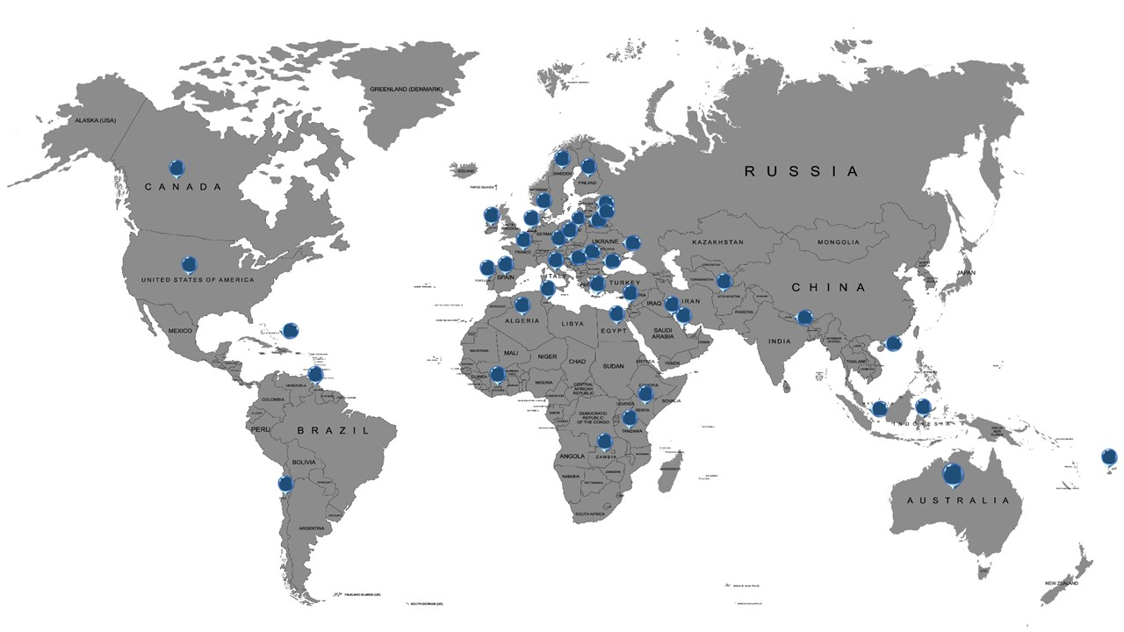



INTERPOL – NCS4
Countries Trained

Slide 9
The Way Ahead
2024 Paris Olympics
2026 World Cup (USA, Canada, Mexico)
2020 Tokyo Olympics
FEMA Crisis Communications Course
2022 World Cup (Qatar-Project STADIA)
2028 Los Angeles Olympics
MPI Best Practices Summit (Barcelona)
International Sports Safety and Security Best Practices Summit
INTERPOL Evacuation Challenges for Major International Sporting Events
INTERPOL Project STADIA Training of Security Forces in Qatar
INTERPOL Crowd Management Challenges for Major International Sporting Events
INTERPOL Incident Management Challenges for Major International Sporting Events
FEMA Advanced Risk Management Course
INTERPOL International Sporting Events: Safety and Security Case Management Launch International Sport Security Professional Certificate Program
Opportunities for Applied Research, Training, Professional Development, and Creating New Knowledge
2018
2019
2020
2022
2024
2026
2028
Stadium Twenty25
In Development
Planning
Long-Term

